Slide 1


APPLICATION CHEMISTRY
A2 LEVEL
ANALYTICAL CHEMISTRY
CHAPTER 5:
MASS SPECTROMETRY

Slide 2
What you should know…
Outline the principles of the mass spectrometer.
Explain the meaning of the terms base peak.
Molecular ion and fragmentation pattern as applied to mass spectra.
Suggest the identity of a molecule based on its fragmentation products.
Deduce the number of carbon atoms in a compound using the M+1 peak.
Deduce the presence of chlorine or bromine in a molecule by use of the M+2 peak

Slide 3
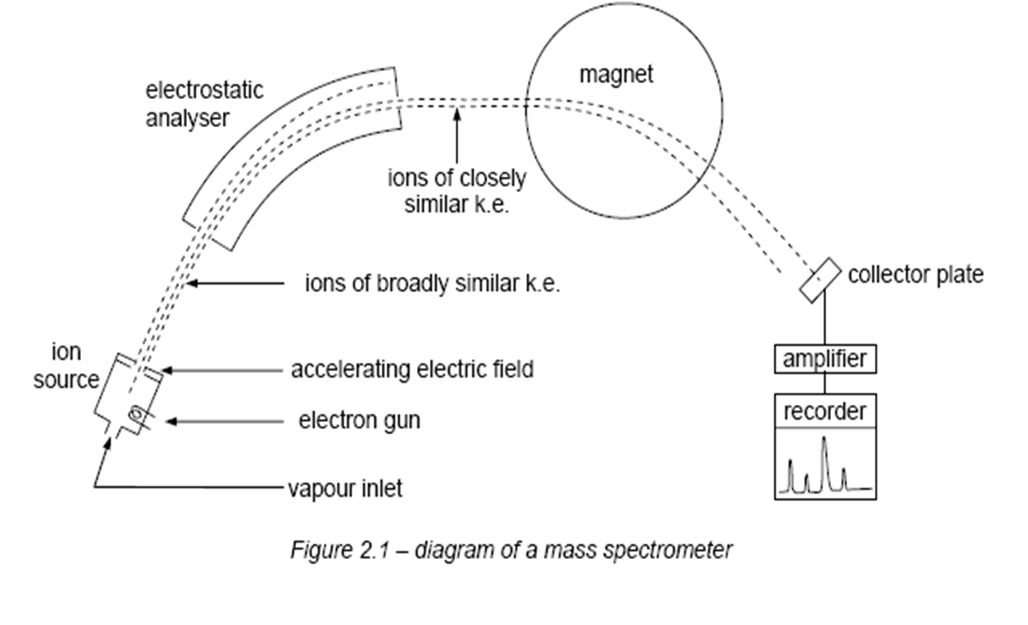
Instrument

Slide 4
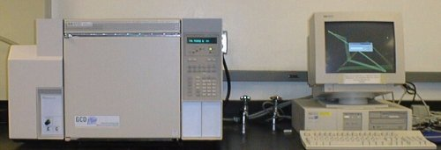

Slide 5
Mass Spectrometer
Six processes occur in a mass spectrometer:
1. Vapourisation chamber: If not already a gas, the compound is vaporised in an oven.
2. Ionisation chamber: Electrons are fired at the gaseous molecules. These knock off other electrons from some of the molecules.

Slide 6
Mass Spectrometer
3. Acceleration chamber: The gaseous ions are accelerated by passing through an electric field.
4. Electrostatic analyser : select ions of kinetic energy within a narrow range by using an electric field.
5. Deflection chamber: The fast-moving ions now pass through the poles of an electromagnet, where they are deflected.
6. The deflected ions pass through a narrow slit and are collected on a metallic plate connected to an amplifier.

Slide 7
Determination Using Mass Spectrometry
Is used to identify unknown or new compounds.
When a molecule is ionised it forms a MOLECULAR ION which can also undergo FRAGMENTATION or RE-ARRANGEMENT to produce particles of smaller mass.
Only particles with a positive charge will be deflected and detected.
The resulting spectrum has many peaks.
The final peak (M⁺) shows the molecular ion (highest m/e or m/z value) and indicates the molecular mass.
The rest of the spectrum provides information about the structure.

Slide 8
Mass spectrum
A mass spectrum is produced, which plots (relative abundance) against (mass/charge (m/e) ratio).
In practice, most ions that are formed in a mass spectrometer have a charge of +1, and so the x-axis is a measure of the masses of the ions.
The y-axis normally shows the abundances of the respective peaks.
The base peak usually corresponds to a particularly stable fragment (most abundant) of the molecules under investigation.

Slide 9
Uses of Mass Spectrometry
Three main ways in which mass spectrometry is applied to the determination of the structures of organic compounds:
By measuring the relative heights of the molecular ion (M) peak and the (M+1) peak → can determine the number of carbon atoms in a molecule, and by using the (M+2) and (M+4) peaks (if any) we can identify halogen-containing (Cl of Br)compounds.
By measuring the accurate mass of a molecular ion → can determine its molecular formula.
By identifying the fragments produced when an ion breaks up inside a mass spectrometer → can often piece together the structure of the parent molecule.

Slide 10
Terminology
Molecular ion | The ion obtained by the loss of an electron from the molecule
Base peak | The most intense peak in the MS, corresponds to a particular stable ion, assigned 100% intensity
M⁺ | Symbol often given to the molecular ion
Radical cation | +ve charged species with an odd number of electrons
Fragment ions | Lighter cations formed by the decomposition of the molecular ion. These often correspond to stable carbocations

Slide 11
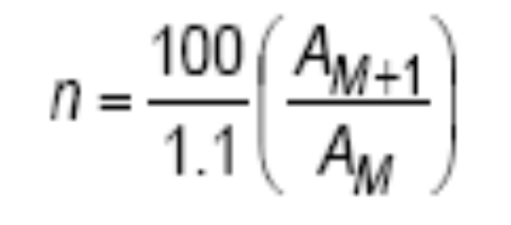
¹²C : ¹³C ratio
Naturally-occurring carbon is composed of 98.9% ¹²C and 1.1% ¹³C (along with extremely small, and variable, amount of ¹⁴C).
The formula relating the (M+1)/(M) ratio the number of carbon atoms is:
where
n = number of carbon atoms
A_{M+1} = the abundance of the M+1 peak
A_{M} = the abundance of the molecular ion, M, peak.

Slide 12
Example 1(pg 58)
Compound A has a molecular ion at an m/e value of 120, and relative abundance 23%, and a peak at m/e 121 with a relative abundance of 2%. How many carbon atoms are in a molecule of A?
Answer:
n = (100/1.1) x (2/23) = 7.91
The nearest whole number is 8.
Therefore compound A has 8 carbon atoms per molecule.

Slide 13
SAQ 1 (pg 66)
Compound B contains carbon, hydrogen and oxygen only. Its mass spectrum contains a molecular ion peak at m/e = 102 (relative abundance 35%) and an M+1 peak at m/e 103 (1.5%).
Calculate the number of carbon atoms in the molecule, and hence deduce the number of oxygen atoms it contains, and its molecular formula.

Slide 14
Answer
n = 100/1.1 x (1.5/35) = 3.9
= 4.0 (nearest whole no.)
Mr of (O & H) remaining
= 102 – (4 x 12) = 54
Hence, no. of O atoms is 3.
(Mass of three O atoms = 3 x 16
= 48)
Remaining 6 hydrogen atoms

Slide 15
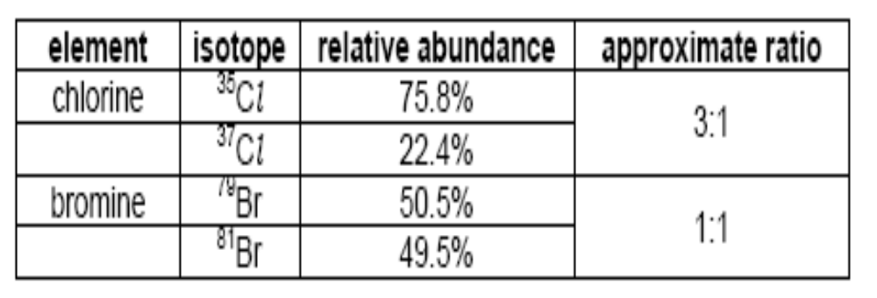
(M), (M+2) and (M+4) peaks
Both Cl & Br naturally occur as mixtures of 2 isotopes, with the relative abundances shown below:
24.2%
If the molecule contains two chlorine atoms, (or two bromine atoms, or one of each) we should expect to see three molecular ions, at m/e values of M, M+2 and M+4.
The ratio of the M:(M+2) peak should reflect the natural abundances given in the table (i.e. 3:1 for chlorine; 1:1 for bromine)

Slide 16
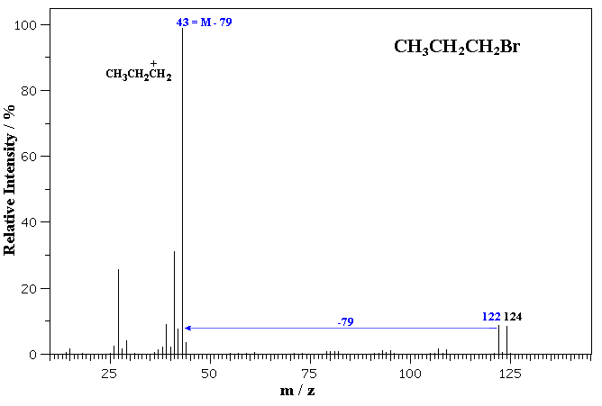
Example: mass spectrum of 1-bromopropane
Note the isotope pattern at 122 and 124 that represent the M and M+2 in a 1:1 ratio.
Note that other peaks, such as those at m/z = 107 and 109 still contain Br and therefore also show the 1:1 isotope pattern.

Slide 17
M+4 peaks
If the molecule contains two chlorine atoms, (or two bromine atoms, or one of each) we should expect to see three molecular ions, at m/e values of M, M+2 and M+4.
E.g. M (⁷⁹Br₂⁺),
M+2 (⁷⁹Br⁸¹Br⁺) and
M+4 (⁸¹Br₂⁺).
The abundance ratio of Br₂ is 1:2:1
The abundance ration of Cl₂ is 9:6:1

Slide 18
Example (pg 58)
dibromomethane, CH₂Br₂,
three molecular ion peaks at m/e 172, 174 and 176 in the ratio 1:2:1.
three molecular ion peaks at m/e 172, 174 and 176 in the ratio 1:2:1,
CH₂⁷⁹Br⁷⁹Br; ( ½ x ½ ) = ¼
CH₂⁷⁹Br⁸¹Br + CH₂⁸¹Br⁷⁹Br; 2( ½ x ½ )=
CH₂⁸¹Br⁸¹Br; ( ½ x ½ ) = ¼
Hence, ratio is 1:2:1
172
2/4
174
176

Slide 19
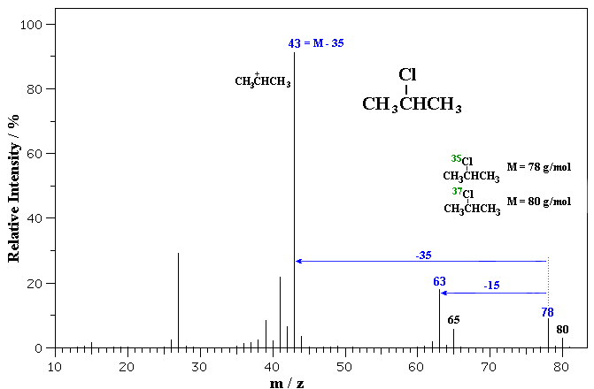
The MS is of 2-chloropropane.
Note the isotope pattern at 78 and 80 that represent the M and M+2 in a 3:1 ratio.
Loss of ³⁵Cl from 78 or ³⁷Cl from 80 gives the base peak a m/z = 43, corresponding to the secondary propyl cation.
Note that the peaks at m/z = 63 and 65 still contain Cl and therefore also show the 3:1 isotope pattern.

Slide 20
Example (pg 58)
dichloromethane, CH₂Cl₂
ratio 9:6:1
due to the greater natural abundance of the ³⁵Cl isotope.
  CH₂³⁵Cl³⁵Cl; ( ¾ x ¾ ) = 9/16
  CH₂³⁵Cl³⁷Cl + CH₂³⁷Cl³⁵Cl; 2( ¾ x ¼ ) = 6/16
  CH₂³⁷Cl³⁷Cl; ( ¼ x ¼ ) = 1/16
Hence, ratio 9:6:1
due to the greater natural abundance of the ³⁵Cl isotope.

Slide 21
SAQ 2 (pg 66)
Calculate the M : M+2 : M+4 ratio for CH₂BrCl

Slide 22
ANSWER
CH₂⁷⁹Br³⁵Cl + CH₂³⁵Cl⁷⁹Br; 2( ½ x ¾ )= ¾
CH₂⁷⁹Br³⁷Cl + CH₂³⁷Cl⁷⁹Br; 2( ½ x ¼ )= ¼
CH₂⁸¹Br³⁵Cl + CH₂³⁵Cl⁸¹Br; 2( ½ x ¾ )= ¾
CH₂⁸¹Br³⁷Cl + CH₂³⁷Cl⁸¹Br; 2( ½ x ¼ )= ¼
hence ratio is 3:4:1
¼ + ¾ = 4/4

Slide 23
Molecular formulae from accurate masses
The following three compounds all have an approximate Mr of 70:
name structure molecular formula
pentene CH₃CH₂CH₂CH=CH₂ C₅H₁₀
aminopropanonitrile CH₃CH(NH₂)CN C₃H₆N₂
but-1-ene-3-one CH₂-CHCOCH₃ C₄H₆O

Slide 24
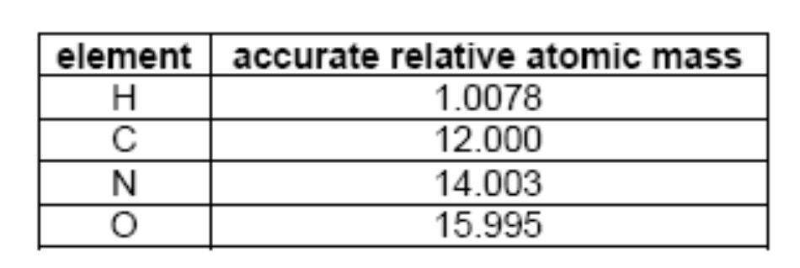
Accurate Masses
C₅H₁₀ = 5 x 12.000 + 10 x 1.0078
= 70.078
C₃H₆N₂ = 3 x 12.000 + 6 x 1.0078 + 2 x 14.003
= 70.053
C₄H₆O = 4 x 12.000 + 6 x 1.0078 + 15.995
= 70.042
The last two differ by abt 0.13%. This is well within the capabilities of a high-resolution mass spectrometer.

Slide 25
SAQ3 (pg 59)
Explain whether a molecule having an accurate mass of 60.0574 is 1,2-diaminoethane, C₂H₈N₂, or
propan-1-ol, C₃H₈O.

Slide 26
ANSWER
CH₂NH₂CH₂NH₂
Mr = 2(12.000) + 8(1.0078)+ 2(14.003)
= 60.0684
CH₃CH₂CH₂OH
Mr = 3(12.000) + 8(1.0078)+ 15.995
= 60.0574
So, the molecule is propan-1-ol

Slide 27
Uses of fragmentation patterns
In ionisation chamber, bombardment by high speed e⁻’s produces positive ions.
The molecular ions formed undergo bond (homolytic) fission to produce molecular fragments:
  1 fragment is +ve ,
  1 is a radical.
M → M⁺ → B• + A⁺
A⁺ appear as further peaks.
B• does not appear as peaks in the spectrum.

Slide 28
Uses of fragmentation patterns
Can be used to identify the structural formulae of compounds.
E.g. Propanone CH₃COCH₃ and
Propanal CH₃CH₂CHO
Both of them have the same molecular of C₃H₆O with m/e = 58

Slide 29
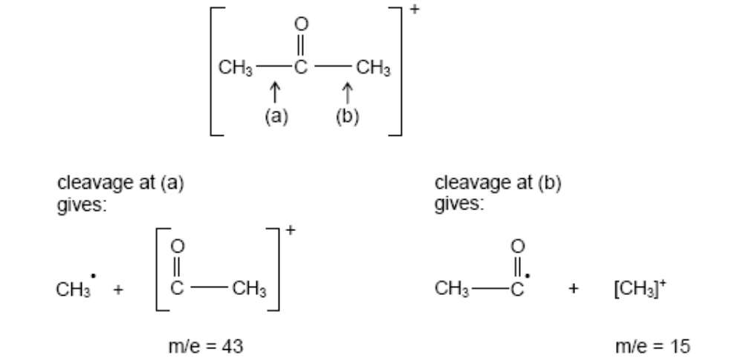
e.g. Propanone

Slide 30
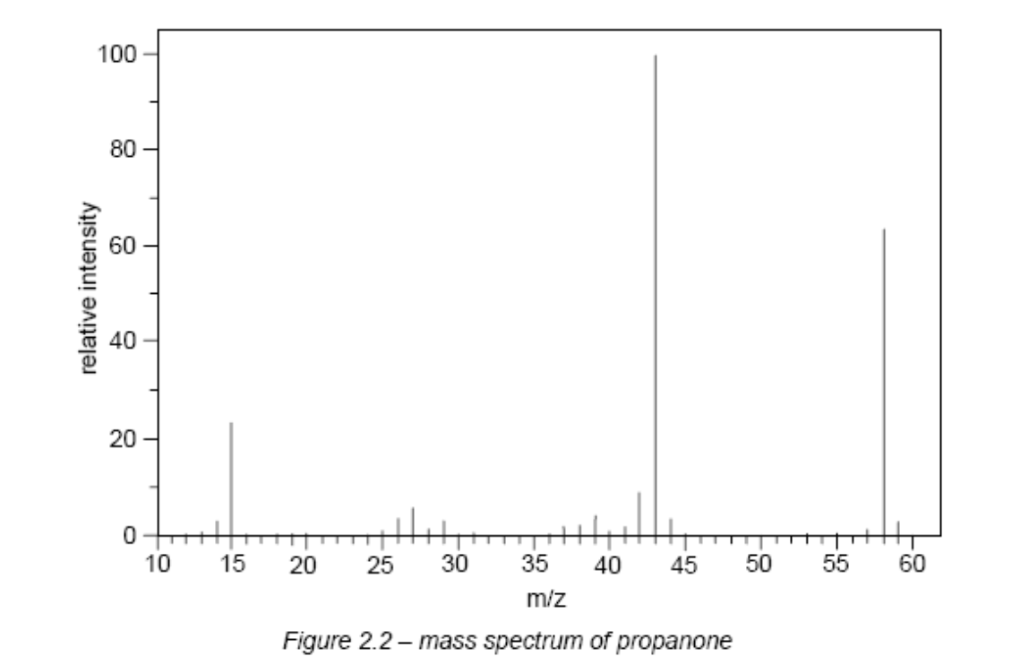
Mass Spectrum of propanone (pg 60)
Highest m/e = 58 due to CH₃COCH₃⁺(whole molecule)
m/e = 43 (base peak) due to (M – 15 = M – CH₃) i.e. CH₃CO⁺
m/e = 15 due to CH₃⁺

Slide 31
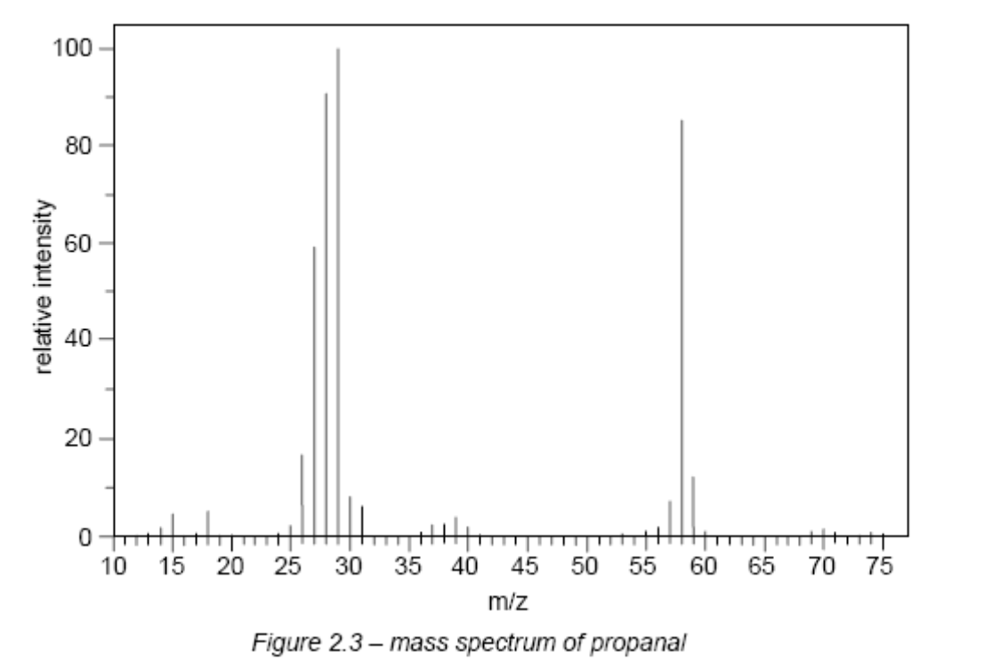
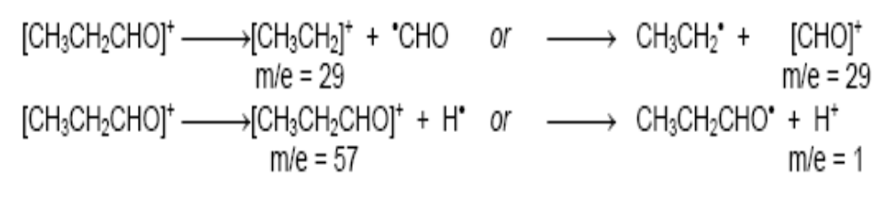
Mass Spectrum of propanal (pg 68)
[CH₃CH₂CO]⁺
CH₃CH₂CO.

Slide 32
SAQ 4 (pg 61)
Use the values of accurate relative atomic masses in the table to see whether it would be possible to decide whether the peak at m/e = 29 is due to CH₃CH₂⁺ or CHO⁺.
CH₃CH₂⁺ = (2x12.000) + (5x1.0078) = 29.039
CHO⁺ = 12.000 + 1.0078 + 15.995 = 29.003
To decide: must use high resolution mass spec.

Slide 33
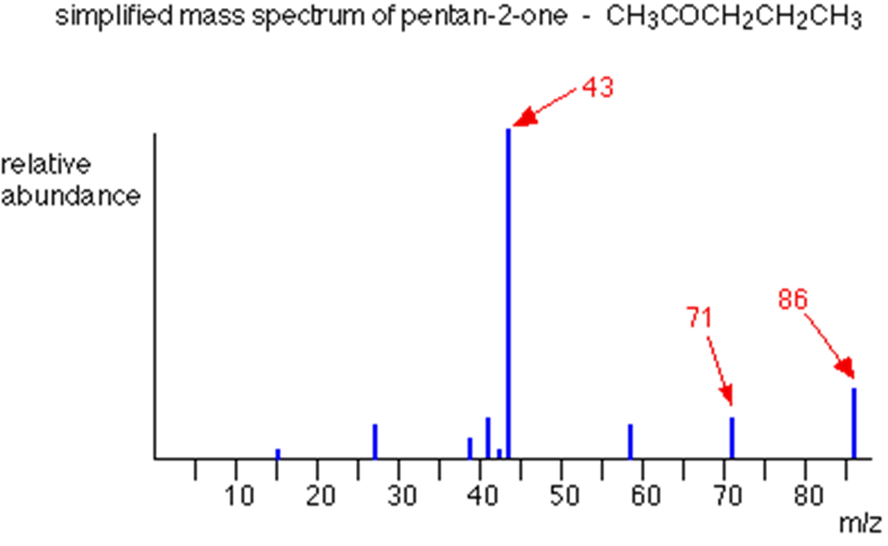
Identify the peaks

Slide 34
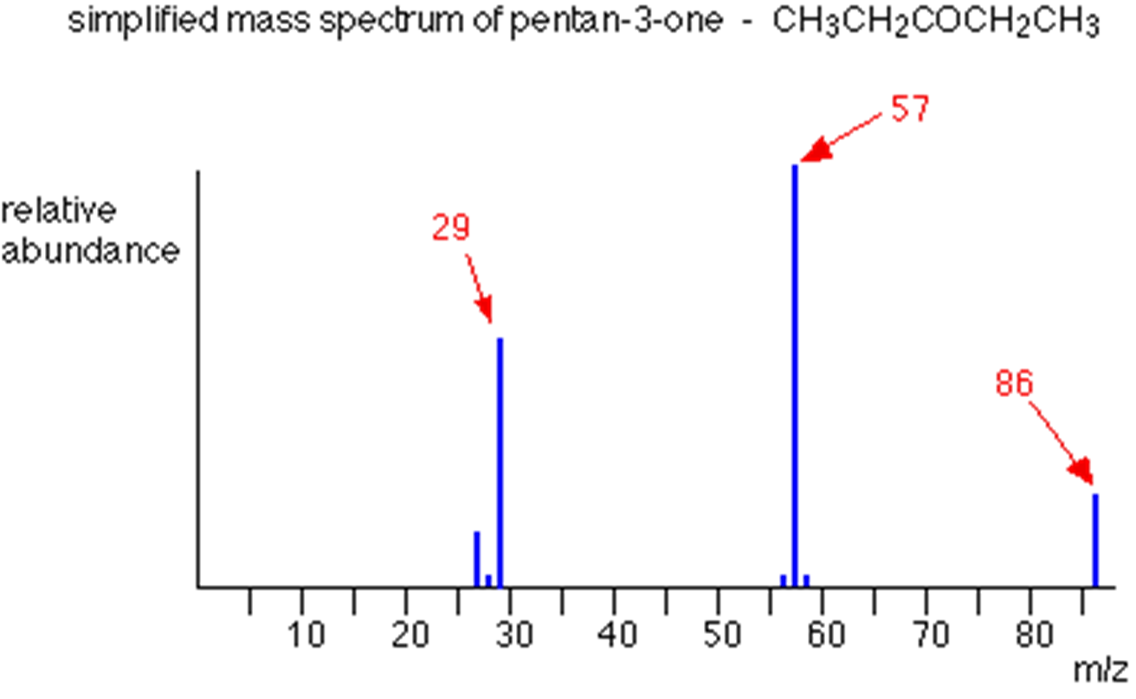
Identify the peaks

Slide 35
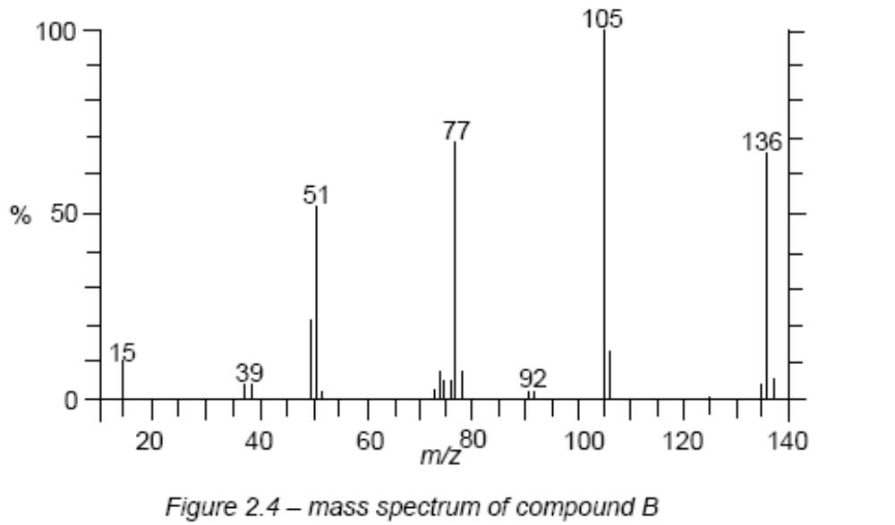
The molecular formula of B is C₈H₈O₂

Slide 36
Compound B
M:M+1 ratio of 11.5 : 1 suggests that it contains 8 carbon atoms,
Accurate determination of its relative atomic mass suggests its molecular formula is C₈H₈O₂.
B could be phenyl ethanoate, methyl benzoate or methyl benzoic acid

Slide 37
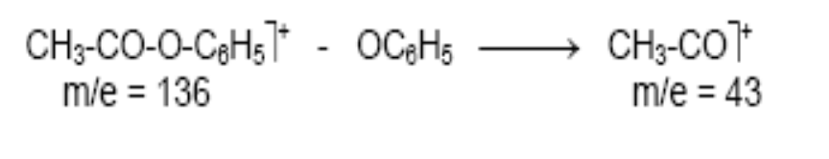

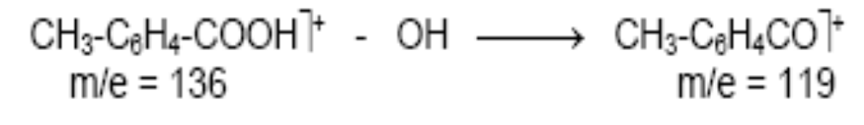
Compound B
phenyl ethanoate
methyl benzoate
methyl benzoic

Slide 38
FRAGMENTATION PATTERNS
ALKANES
The mass spectra of simple hydrocarbons have peaks at m/z values corresponding to the ions produced by breaking C-C bonds.
Peaks can occur at ...
m/z 15 29 43 57 71 85 etc. CH₃⁺ C₂H₅⁺ C₃H₇⁺ C₄H₉⁺ C₅H₁₁⁺ C₆H₁₃⁺
• the stability of the carbocation formed affects its abundance
• the more stable the cation the higher the peak
• the more alkyl groups attached to the carbocation the more stable it is

Slide 39
Ease of formation of carbonium ion fragments
most stable tertiary 3° > secondary 2° > primary 1° least stable
alkyl groups are electron releasing and stabilise the cation
CH₃⁺ < RCH₂⁺ < R₂CH⁺ < R₃C⁺ < CH₂=CH-CH₂⁺ < C₆H₅ – CH₂⁺

Slide 40
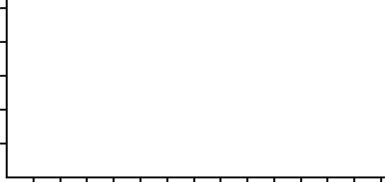
THE MASS SPECTRUM - FRAGMENTATION
The rest of the spectrum provides additional information of the molecule’s structure.
Peaks appear due to characteristic fragments (e.g. 29 due to C₂H₅⁺) and differences between two peaks also indicates the loss of certain units (18 for H₂O, 28 for CO).
Octane
C₈H₁₈
43
20 40 60 80 100
Abundance %
29
57
71
85
114
.
0
me
10 20 30 40 50 60 70 80 90 100 110 120 130 140

Slide 41
IDENTIFY THE COMPOUND
Base peak at 43, possible ion: C₃H₇⁺ or
CH₃CO⁺
43
CH₃CH₂CH₂⁺
29
Abundance %
20 40 60 80 100
CH₃CH₂CH₂Br
-79
122 124
122-43 = 79
Shows ⁷⁹Br
present
79 81
0
m/z
10 20 30 40 50 60 70 80 90 100 110 120 130 140
CH₃CH₂CH₂Br

Slide 42
IDENTIFY THE COMPOUND
Base peak at 105 possible ion: C₆H₅CO⁺
105
77
51
Abundance %
20 40 60 80 100
120
43
28
0
m/z
10 20 30 40 50 60 70 80 90 100 110 120 130 140
120-105=15; shows possible CH₃
C₆H₅COCH₃

Slide 43
FRAGMENTATION PATTERNS
HALOGENOALKANES
Multiple peaks occur in the molecular ion region due to different halogen isotopes.
There are two peaks for the molecular ion of C₂H₅Br, one for the molecule containing the isotope ⁷⁹Br and the other for the one with the ⁸¹Br isotope.
Because the two isotopes are of similar abundance, the peaks are of similar height.
molecular ion contains...⁷⁹Br ⁸¹Br
20 40 60 80 100
Abundance %
0
m/e
10 20 30 40 50 60 70 80 90 100 110 120 130 140

Slide 44
Fragment | Possible Group | Possible Inference
29 | CHO⁺, C₂H₅⁺
30 | CH₂=NH₂⁺ | primary amine
31 | CH₂=OH⁺ | primary alcohol
41 | C₃H₅⁺ | allyl group
43 | C₃H₇⁺ CH₃CO⁺ | propyl group acyl group
50 | C₄H₂⁺ | aromatic
51 | C₄H₃⁺ | phenyl group
57 | C₄H₉⁺ C₂H₅CO⁺ | butyl group ethyl ketone, propionate ester
58 | CH₂=C(OH)CH₃⁺ | methyl ketone (McL. Rear.)
59 | CO₂CH₃⁺ CH₂=C(OH)NH₂⁺ | methyl ester primary amide (McL. Rear.)
60 | CH₂=C(OH)OH⁺ | carboxylic acid (McL. Rear.)
71 | C₅H₁₁⁺ C₃H₇CO⁺ | pentyl group propyl ketone, butyrate ester
74 | CH₂=C(OH)OCH₃⁺ | methyl ester (McL. Rear.)
76 | C₆H₄⁺ | mono or disubstituted benzene
77 | C₆H₅⁺ | phenyl
85, 99 | C_{c}H_{2c+1}⁺ | benzyl group
91 | C₇H₇⁺ | alkyl group
105 | C₆H₅CO⁺ | benzoyl group

Slide 45
Common Small Ions
m/z | composition
15 amu | CH₃
17 | OH
18 | H₂O
19 | H₃O, F
26 | C₂H₂, CN
27 | C₂H₃
28 | C₂H₄, CO, H₂CN
29 | C₂H₅, CHO
30 | CH₂NH₂
31 | CH₃O
33 | SH, CH₂F
34 | H₂S
35(37) | Cl
36(38) | HCl
39 | C₃H₃
41 | C₃H₅, C₂H₃N
42 | C₃H₆, C₂H₂O, C₂H₄N
43 | C₃H₇, CH₃CO
44 | C₂H₄O
46 | NO₂
56 | C₄H₈
57 | C₄H₉
60 | CH₄CO₂
79(81) | Br
80(82) | HBr
91 | C₇H₇
127 | I
128 | HI
Common Neutral Fragments
mass loss | composition
1 amu | H
15 | CH₃
17 | OH
18 | H₂O
19 | F
20 | HF
27 | C₂H₃, HCN
28 | C₂H₄, CO
30 | CH₂O
31 | CH₃O
32 | CH₄O, S
33 | CH₃ + H₂O, HS
33 | H₂S
35(37) | Cl
36(38) | HCl
42 | C₃H₆, C₂H₂O, C₂H₄N
43 | C₃H₇, CH₃CO
44 | CO₂O, CONH₂
45 | C₂H₅O
55 | C₄H₇
57 | C₄H₉
59 | C₂H₃O₂
60 | C₂H₄O₂
64 | SO₂
79(81) | Br
80(82) | HBr
127 | I
128 | HI

Slide 46
APPLICATIONS
By coupling a GLC in conjunction with a mass spectrometer, rapid analysis of complex mixtures is possible.
This is particularly useful for determining the products and relative yields from organic reactions and for monitoring industrial processes.
Mass spec. are suitable for analyzing volatile compounds.
It can also be used to analyze proteins and polypeptides. This is achieved by methylating the –N-H groups which disrupts the hydrogen bond, hence more volatile.
This allows a very rapid method of determining the a.a sequence in the molecules.
This technique is usually computer-linked and has the advantage that very small quantities are required and sequences of amino acids
may be rapidly established.
Notes:
Methylation denotes the addition of a methyl group to a substrate or the substitution of an atom or group by a methyl group.
Methylation is a form of alkylation with a methyl group, rather than a larger carbon chain, replacing a hydrogen atom.

Slide 47
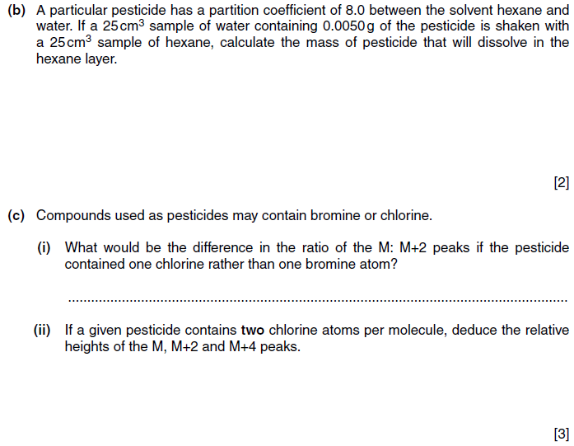
Past year : oct/nov 2009/42/ Q8

Slide 48
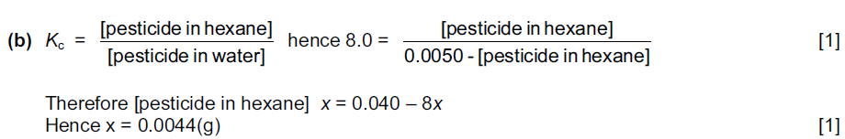
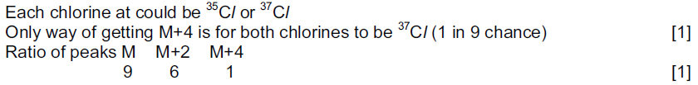
Past year : oct/nov 2009/42/ Q8

